Slide 1
ECN 310 Final Project
Erik Romero, Carson Szilagyi, Ekamjot Gill

Slide 2

Motivation
Prices of gasoline are a definitive factor in cost of living
Increases in gas prices directly affect american commuters
Gasoline prices also have far reaching secondary effects on the cost of transportation and travel, which affect prices of most consumer goods

Slide 3
Background
Variables
Data Sources
Gasoline Prices (Y) (univariate and multivariate regression)
Crude oil prices (X) (univariate and multivariate regression)
Average US gas taxes (multivariate regression)
Crude oil refining cost (multivariate regression)
Unit of observation is US dollars
Energy Information Administration (EIA)
This is a US government agency focused on producing data to inform policy and research
Due to this it is considered a very reliable source

Slide 4
Notebook
Experimental Design
We used univariate regression to capture the main relationship of interest: between crude oil and gasoline prices
We next extended our relationship of interest to include refining cost and taxes, which we believed could be responsible for part of the change in gasoline prices
In this way we were able to capture and control for more potentially explanatory variables
We used libraries discussed in class (numpy, pandas, matplotlib etc) to perform our analysis
We also cleaned and refined our data so that it only contained the years 2020-2026, as we felt this was a relevant timeframe and would only cover prices post COVID-19, which would help to avoid distortion in results.

Slide 5
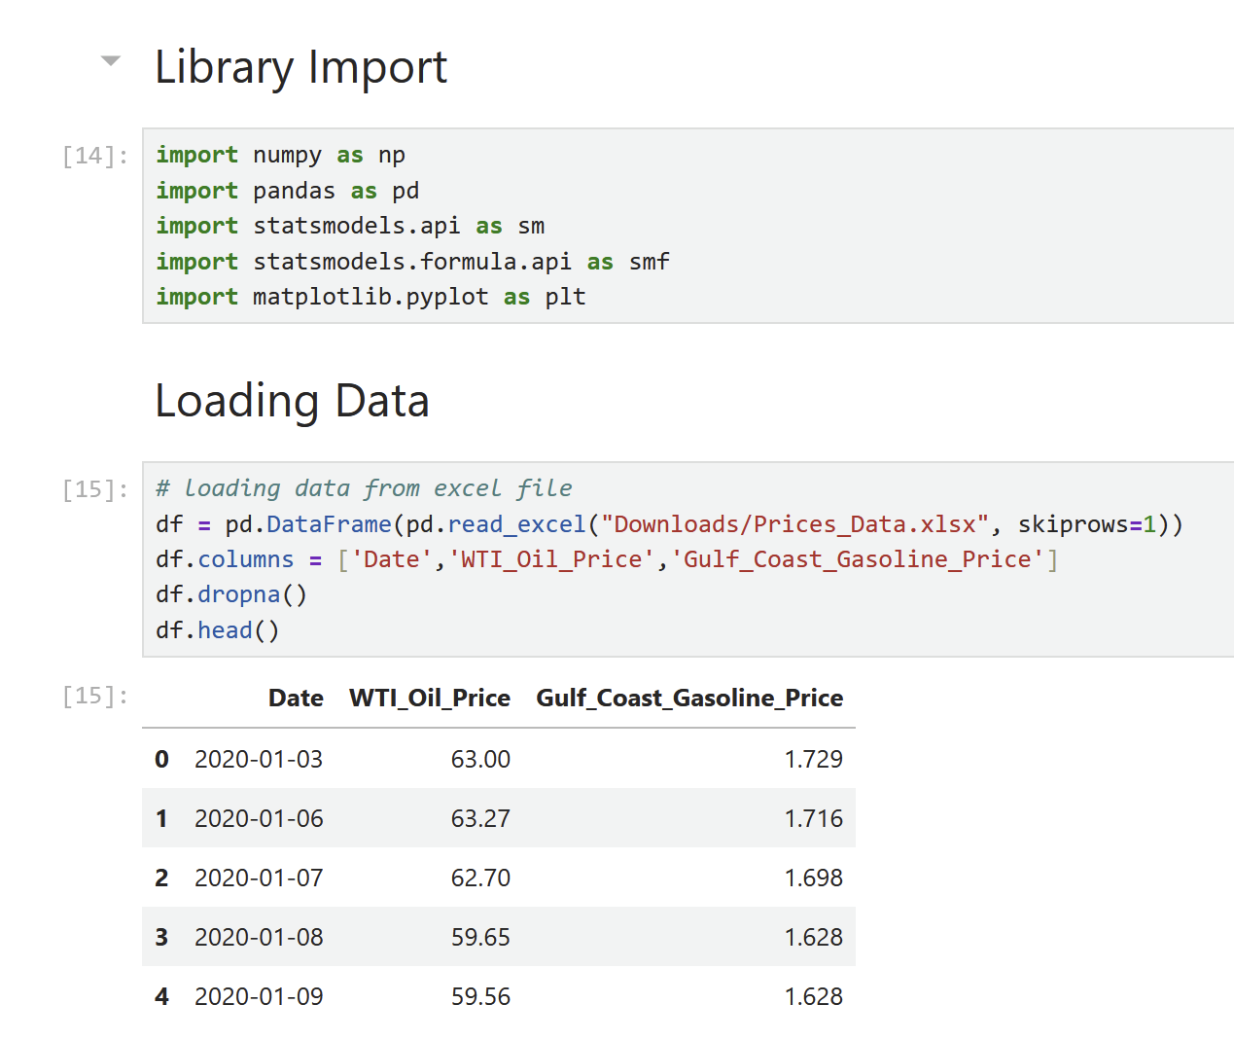
Notebook
Import and Data Cleaning
We imported the relevant libraries
We loaded the data from an excel file and named the columns
We then removed any rows missing values
Finally we displayed the first rows to make sure it works.

Slide 6
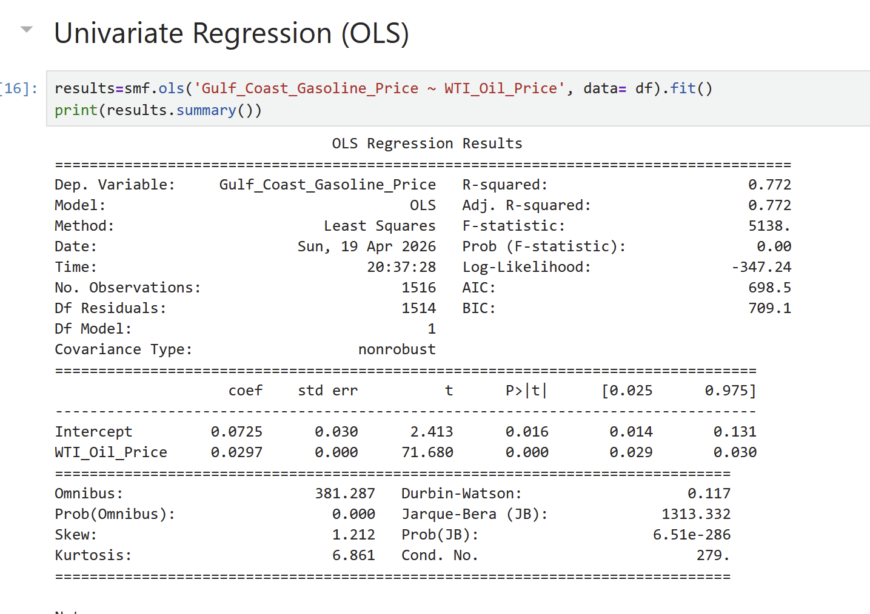
Notebook
Univariate Regression
We performed an OLS linear regression using crude oil as the independent (x) variable and Gulf Coast Gasoline as the dependent variable (y)
A 1 dollar increase in the price of a barrel oil is correlated to a ~3 cent increase in the price of a gallon gasoline
We received conclusive evidence that there is a correlation between the crude oil and gulf coast gasoline prices
R²: ~ 77% of variance in gas prices is explained by oil price

Slide 7
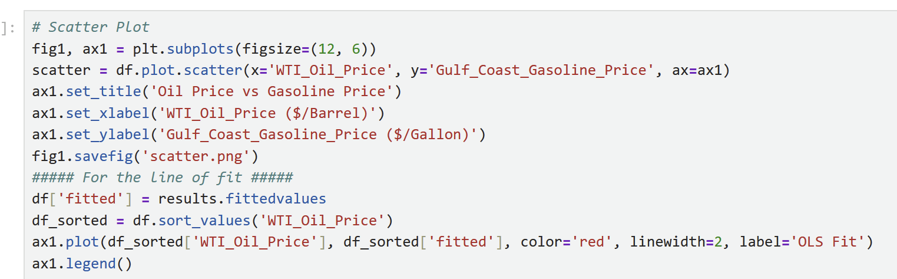
Notebook
Scatter Plot

Slide 8
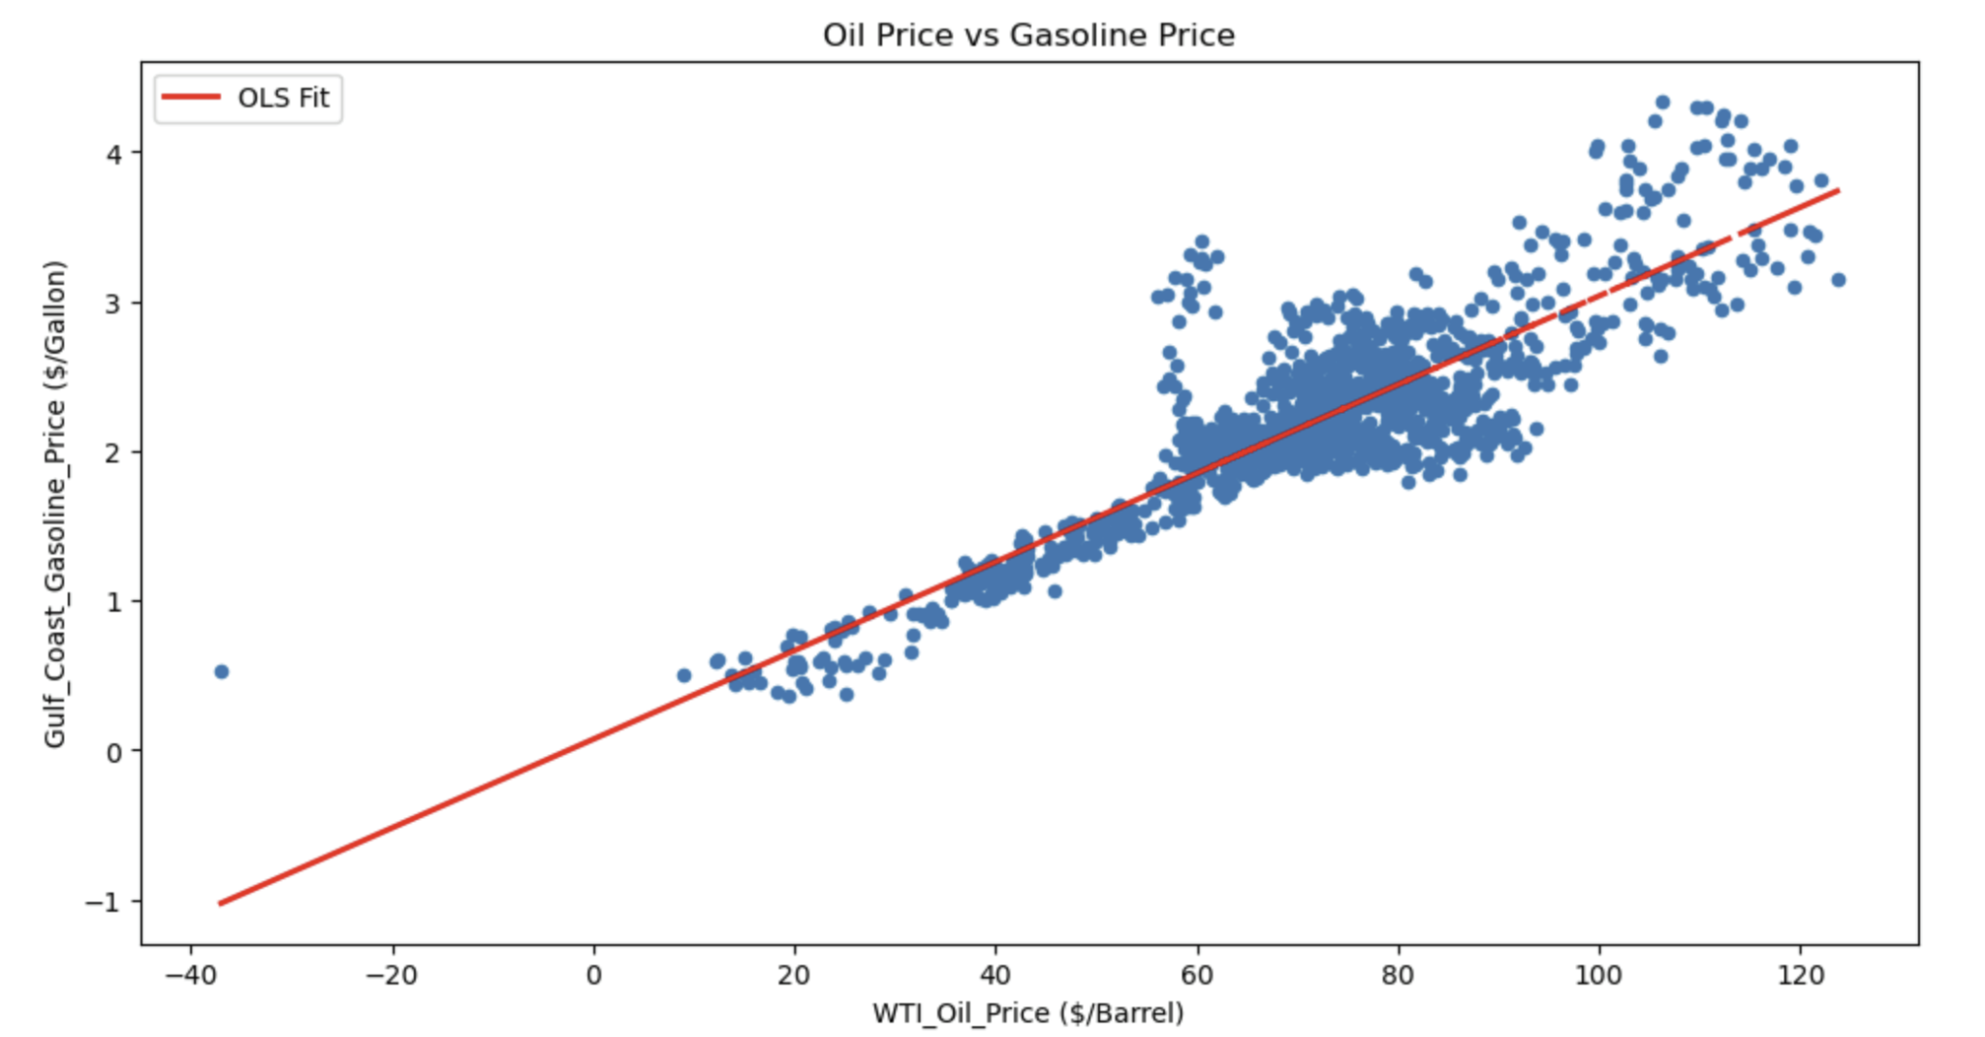
Notebook
Scatter Plot

Slide 9
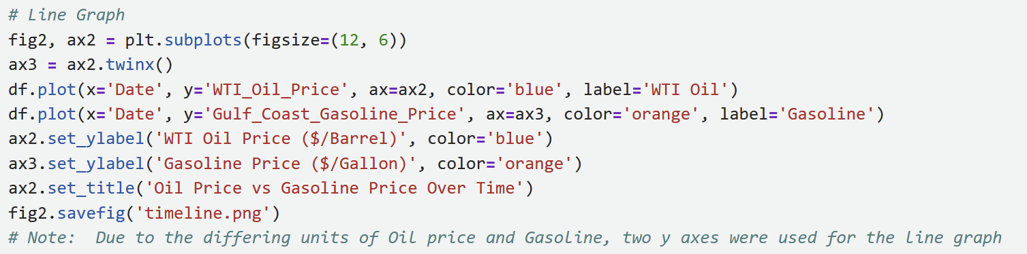
Notebook
Line/Time Graph

Slide 10
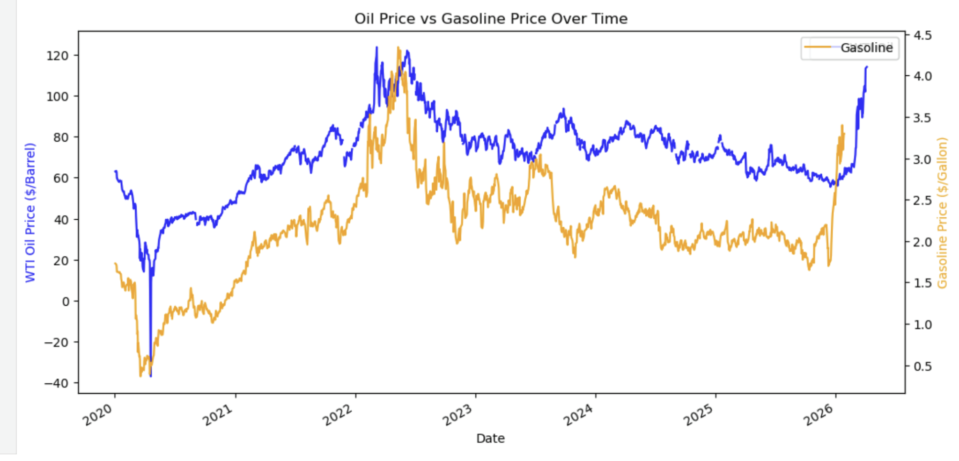
Notebook
Line/Time Graph

Slide 11
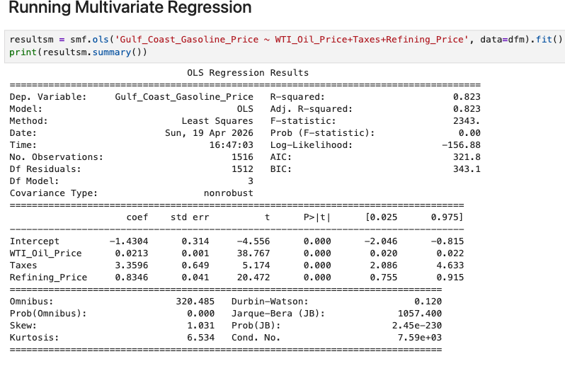
Notebook
Multivariate
R^2 Increased from .772 to .823
About 82% of the Variation in U.S. gulf coast gas prices is explained by our model.
Coefficients
Crude oil : $1 ^ = $ .021 cent increase in gas prices
Taxes: $1 ^ = $3.35 increase in gas prices.
Refining cost: $1 ^ = $ .83 cent increase in gas prices

Slide 12
Causation?
Correlation is NOT causation
A change in price of oil does not cause a change in price of gas
High degree of association between the variables

Slide 13
Limitations
Omitted Variables
Inventory stockpiles or shortages
Way of sourcing oil
Demand for oil

Slide 14
Causal Methods
Policy Change
Trade sanctions and Embargoes
Oil reserve releases
Fuel regulations and other incentives
Production Regulations

